Slide 1
All about: Dematerialization of Shares
By CS Nupur Choudhuri, Practicing
Company Secretary.

Slide 2
What is Dematerialization?
Dematerialization is the process of converting the Physical securities into electronic form and upon conversion, crediting the electronic shares in the Demat Account of the Investor.
Dematerialized Shares receive credits and bonuses directly into their linked bank accounts. Further, it helps to reduce the concept of “benami” shareholders and increases transparency within Companies.

Slide 3
What does “securities” include?
The Companies Act, 2013, draws reference to Section 2(h) of the Securities Contracts (Regulations) Act, 1956, and securities include,
(i) shares, scrips, stocks, bonds, debentures, debenture stock or other marketable securities of a like nature in or of any incorporated company or other body corporate;
(ia) derivative;
(ib) units or any other instrument issued by any collective investment scheme to the investors in such schemes;
(ic)security receipt as defined in clause (zg) of section 2 of the Securitisation and Reconstruction of Financial Assets and Enforcement of Security Interest Act, 2002

Slide 4
What does “securities” include?
The Companies Act, 2013, draws reference to Section 2(h) of the Securities Contracts (Regulations) Act, 1956, and securities include,
(id) units or any other such instrument issued to the investors under any mutual fund scheme.
ii) Government securities;
(iia) such other instruments as may be declared by the Central Government to be securities; and
(iii) rights or interest in securities;

Slide 5
01
September 12, 2014: Section 29 of the Companies Act, 2013 mandating issue of securities in dematerialized form by Public Listed Companies.
How Dematerialization was mandated by the Regulators
02
Companies (Prospectus and Allotment of Securities) (Third Amendment) Rules, 2018 dated 10TH September 2018: ALL Unlisted Public Companies will issue and transfer ALL its securities in Dematerialized Form only.
03
Companies (Prospectus and Allotment of Securities) (Third Amendment) Rules, 2019 dated May 22, 2019: Mandating submission of Form PAS-6 on a Half-Yearly Basis with the ROC.
04
Companies (Prospectus and Allotment of Securities) (Second Amendment) Rules, 2023, dated October 27, 2023: Insertion of Rule 9B wherein Mandatory Dematerialization introduced for Share Warrants Issuers and Private Companies.

Slide 6
Section 29 of the Companies Act, 2013
(1) Notwithstanding anything contained in any other provisions of this Act,
(a) every company making public offer ; and
(b) such other class or classes of public companies as may be prescribed,
shall issue the securities only in dematerialized form by complying with the provisions of the Depositories Act, 1996 and the regulations made thereunder.
(1A) In case of such class or classes of unlisted companies as may be prescribed, the securities shall be held or transferred only in dematerialized form in the manner laid down in the Depositories Act, 1996 and the regulations made thereunder.
(2) Any company, other than a company mentioned in sub-section (1), may convert its securities into dematerialized form or issue its securities in physical form in accordance with the provisions of this Act or in dematerialized form in accordance with the provisions of the Depositories Act, 1996, and the regulations made thereunder.

Slide 7
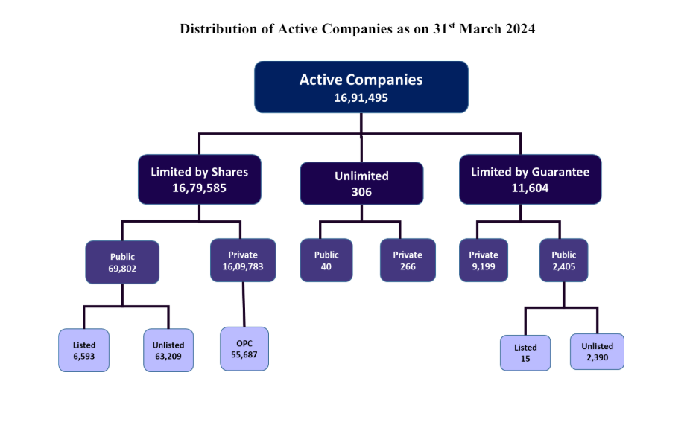
Analysing the Current Situation in India

Slide 8
Analysing the Current Situation in India
As sourced by the Monthly Information Bulletin released by the Ministry of Corporate Affairs, on October 31, 2023, there were 15,84,116 Private Companies in India.
As sourced by the Monthly Information Bulletin released by the Ministry of Corporate Affairs, on March 31, 2024, there were 16, 09783 Private Companies , limited by shares in India.
Out of the aforesaid Data for March, 2024, around 55,687 were One Person Companies (OPCs).
As on April 30, 2024, NSDL has 3,60,57,704 active client accounts. CDSL on the other hand, has 11,83,91,409 active client accounts.

Slide 9
Discussing the formerly introduced Rule 9A...
Inserted vide the Companies (Prospectus and Allotment of Securities) Third Amendment Rules, 2018, on September 10, 2018,
1) Every unlisted public company shall –
(a) issue the securities only in dematerialized form; and
(b) facilitate dematerialization of all its existing securities
in accordance with provisions of the Depositories Act, 1996 and regulations made there under.
(2) Every unlisted public company making any offer for issue of any securities or buyback of securities or issue of bonus shares or rights offer shall ensure that before making such offer, entire holding of securities of its promoters, directors, key managerial personnel has been dematerialized in accordance with provisions of the Depositories Act 1996 and regulations made there under.

Slide 10
Discussing the formerly introduced Rule 9A...
(3) Every holder of securities of an unlisted public company,
(a) who intends to transfer such securities on or after 2nd October, 2018, shall get such securities dematerialized before the transfer; or
(b) who subscribes to any securities of an unlisted public company (whether by way of private placement or bonus shares or rights offer) on or after 2nd October, 2018 shall ensure that all his existing securities are held in dematerialized form before such subscription.
(4) Every unlisted public company shall facilitate dematerialization of all its existing securities by making necessary application to a depository as defined in clause (e) of sub-section (1) of section 2 of the Depositories Act, 1996 and shall secure International Security Identification Number (ISIN) for each type of security and shall inform all its existing security holders about such facility.

Slide 11
Discussing the formerly introduced Rule 9A...
(5) Every unlisted public company shall ensure that-
(a) it makes timely payment of fees (admission as well as annual) to the depository and registrar to an issue and share transfer agent in accordance with the agreement executed between the parties;
(b) it maintains security deposit at all times, of not less than two years, fees with the depository and registrar to an issue and share transfer agent in such form as may be agreed between the parties; and
(c) it complies with the regulations or directions or guidelines or circulars, if any, issued by the securities and Exchange Board or Depository from time to time with respect to dematerialization of shares of unlisted public companies and matters incidental or related thereto.
(6) No unlisted public company which has defaulted in sub-rule (5) shall make offer of any securities or buyback its securities or issue any bonus or right shares till the payments to depositories or registrar to an issue and share transfer agent are made.

Slide 12
Discussing the formerly introduced Rule 9A...
(7) Except as provided in sub-rule(s), the provisions of the Depositories Act 1996, the securities and Exchange Board of India (Depositories and participants) Regulations, 2018 Regulations, 1996 and the securities and Exchange Board of India (Registrars to an Issue and share Transfer Agents) Regulations, 1993 shall apply mutatis mutandis to dematerialisation of securities of unlisted public companies.
(8) Every unlisted public company governed by this rule shall submit Form PAS-6 to the Registrar with such fee as provided in Companies (Registration Offices and Fees) Rules, 2014 within sixty days from the conclusion of each half year duly certified by a Company Secretary or Chartered Accountant in practice.
(8A) The company shall immediately bring to the notice of the depositories any difference observed in its issued capital and the capital held in dematerialized form.
(9) The grievances, if any, of security holders of unlisted public companies under this rule shall be filed before the Investor Education and protection Fund Authority.

Slide 13
Discussing the formerly introduced Rule 9A...
(10) The Investor Education and protection Fund Authority shall initiate any action against a depository or participant or registrar to an issue and share transfer agent after prior consultation with the securities and Exchange Board of India.
(11) This rule shall NOT APPLY to an unlisted public company which is:—
(a) a Nidhi;
(b) a Government company or
(c) a wholly owned subsidiary

Slide 14
Discussing the newly introduced Rule 9B....
On October 27, 2023, the Ministry of Corporate Affairs notified the Companies (Prospectus and Allotment of Securities) Second Amendment Rules, 2023, causing a major stir amongst Companies and Professionals.
Understanding the Applicability?
Every Private Company, OTHER THAN Small Company, is now required to ensure compliance with the provisions of Rule 9B.
However, specific exemption has been granted to Government Companies.

Slide 15
Discussing the newly introduced Rule 9B....
Now, there exists a dispute as to whether such applicability shall extend to:
a. Section 8 Companies,
b. Private Companies which are holding/ subsidiaries of other Private Companies,
c. Private Companies, which are subsidiaries of Public Companies, and,
d. Wholly Owned Subsidiaries of such Private Companies?

Slide 16
What does the Rule entail?
Every Private Company, other than a Small Company, shall be required to:
a) Issue securities ONLY in Dematerialized Form.
b) Facilitate Dematerialization of ALL its Existing Securities.
Timeline for Compliance?
Any Company, not a Small Company as on March 31, 2023, or in the subsequent financial years, shall ensure compliance with the provisions of these Rules by September 30, 2024
Q. What if a Company was initially a Small Company on March 31, 2023, and during the year, breaches the turnover limit ?

Slide 17
Prohibited Transactions
Now, let us take a look at all the prohibited transactions in the absence of dematerialization of shares?
Problem 01
Problem 02
Problem 03
Every Eligible Private Company making any offer for transfer of securities, shall be required to ensure that the shares are dematerialized before undertaking such transfer.
Further, any issuance or buyback, bonus or right issue shall not be made unless the entire holding of Directors, Promoter, KMP is dematerialized.
Subscribers of a security subscribing by way of rights issue, private placement or bonus issue shall ensure that the Company has complied with such rules, before subscription.

Slide 18
Additional Compliances?
Rule 9B further states that the provisions of sub-rule (4) to (10) of Rule 9A shall apply in entirety to such Eligible Private Companies.
Compliance 1
Compliance 2
Compliance 3
Obtaining the International Security Identification Number (ISIN) for each of its securities.
Informing all the security holders about the obtainment of ISIN.
Appointment of a RTA and Depository and ensure the following,
Payment of timely fees;
Maintenance of Security Deposit. and,
Tripartite Agreement.
Filing of E-Form PAS-6 on a half-yearly basis with the Registrar of Companies.
Due date: Within 60 days from the conclusion of each half-year.

Slide 19
What is ISIN?
An International Securities Identification Nmber (ISIN) is a 12-digit alphanumeric code that is used to identify a particular security.
It is issued by the National Numbering Agency, present in each respective countries.
The first 2 digits are the country of origin, the 9 digits in between for unique identification of security and the last digit is the Check Code.

Slide 20
Additional Compliances?
List of Additional Compliances
Grievances of the security holders to be filed with the Investor Education and Protection Fund Authority (IEPF).
Comply with regulations or directions or guidelines, as issued by SEBI or Depository, from time to time.
In case of any default in payment of Fees/Deposits- The Pvt. Co shall not make any offer or issuance of securities till the payments are made.
The Company shall immediately bring to the notice of the Depositories, any difference ketween the Issued Capital and the Capital held in Dematerialized Form.
Provisions of Depositories Act, 1996, SEBI (Depositories and Participants) Regulations, 2018 and SEBI (Registrars to an Issue and Share Transfers Agent) Regulations, 1993 shall apply mutatis mutandis.

Slide 21
PROCESS OF DEMATERIALIZATION
Select Depository
Appointment of a Registrar and Share Transfer Agent
Documents submitted with Depository
In India, there are two Central depositories, namely NSDL and CDSL.
Company has to choose one, keeping in mind if any of their shareholders already have their chosen depositories or not.
The Registrar and Share Transfer Agent is a SEBI registered entity that shall act as an agent of the Issuer.
It acts as an Intermediary between the Depository and the Issuer Company, as well as takes care of all the documentation.
A set of documents are required to be submitted by the Issuer Company with the concerned depository.
The checklist of all documents required has been uploaded on the website of NSDL/CDSL.
I

Slide 22
DOCUMENTATION REQUIRED
Issuer Admission Process @ NSDL
Some Important Documents required for the purpose of obtaining ISIN include,
Application for admission as an Issuer.
Net Worth Certificate from a Practicing Chartered Accountant as per the last audited Annual accounts.
Tripartite Agreement executed between the Issuer Company, Depository and RTA.
Certified copies of Memorandum and Articles of Association along with the Certificate of Incorporation.

Slide 23
DOCUMENTATION REQUIRED
Issuer Admission Process @ CDSL
Some Important Documents required for the purpose of obtaining ISIN include,
Master Creation Form (MCF)
Net Worth Certificate from a Practicing Chartered Accountant as per the last audited Annual accounts.
Tripartite Agreement executed between the Issuer Company, Depository and RTA.
Certified copies of Memorandum and Articles of Association along with the Certificate of Incorporation.

Slide 24
DOCUMENTATION REQUIRED
Issuer Admission Process @ CDSL
Some Important Documents required for the purpose of obtaining ISIN include,
Letter for Freezing/Unfreezing of securities.
Undertaking (In case of Private Limited Companies).
Security Details (In Excel Format)
Further, in case of Private Companies, in order to ensure that the holders DO NOT TRANSFER the securities in dematerialised form, depositories offer an optional facility to keep the ISIN under the status, ‘Frozen for Debit’.

Slide 25
PROCESS OF DEMATERIALIZATION
Intimation to security holders
Security Holders coordinate with Depository Participant
Completion of Entire Process
Security Holders shall be intimated by the Company that ISIN has been obtained and they are required to proceed for dematerialization of shares.
The Client shall submit a Dematerialization Request Form (DRF) with the concerned Depository Participant. Along with it, the share certificates are also required to be submitted.
The DP shall scrutinize and verify all the documents.
The entire process shall be completed in 2-3 weeks.
Once completed, the shares of the particular company will be credited by the Depository in the respective Shareholder’s Demat Account.

Slide 26
COST INVOLVED
ENGAGING A DEPOSITORY

Slide 27
PENALTY FOR NON-COMPLIANCE
It will amount to a breach of Section 29 of the Companies Act, 2013.
In the absence of any specific penalty outlined for non-compliance, Section 450 of the Companies Act, 2013 is automatically invoked, which becomes applicable to penalize any violation of the newly introduced Rule 9B.
Company AND Every Officer-in-default: 10,000/-
In cases of continuing default?
An additional penalty of Rs. 1,000/- per day will be imposed, subject to maximum Rs. 2,00,000/- (Rupees Two Lakhs Only) for the company and Rs. 50,000/- (Rupees Fifty Thousand Only) for any officer in default.

Slide 28
ADVANTAGES OF DEMATERIALIZATION
Direct Benefit Transfer (DBT) Scheme was implemented in 2013, to increase transparency and reduce the possibility of fraud in distribution of Government funds.
DEMAT is a similar transparency system which ensures that all the beneficiaries receive the benefits in their bank accounts.
DEMAT enables the government to trace the purchase and sale of securities of private companies and the interests of the investors can be protected. DEMAT enables to enhance corporate governance of the capital markets.
The manipulation of shares in private companies becomes difficult with the help of dematerialization, as the ownership of the shares can be monitored.

Slide 29
ADVANTAGES OF DEMATERIALIZATION
DEMAT also helps to prevent Benami Transactions, wherein on party holds the assets and other party pays for it and the beneficial owner is someone other that the person who has the title of the asset.
Compulsory DEMAT of securities prevents the formation of shell companies. These are companies which exist without employees, assets or property, with the intention of committing fraud. Through DEMAT, the audit traces can also be examined.
Compulsory dematerialization of shares enables the regulatory authorities to keep a track of the PAN and Aadhar card details, which in turn reduces the possibility of personation of shareholders. The shareholders cannot falsely claim to be a shareholder of a particular company.

Slide 30
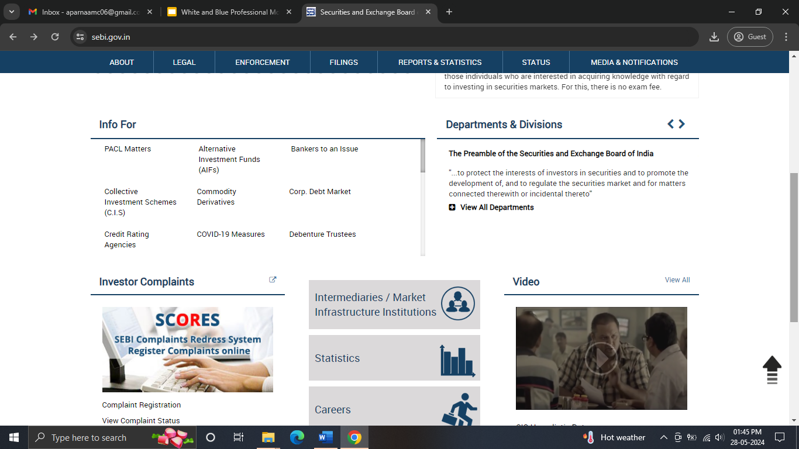
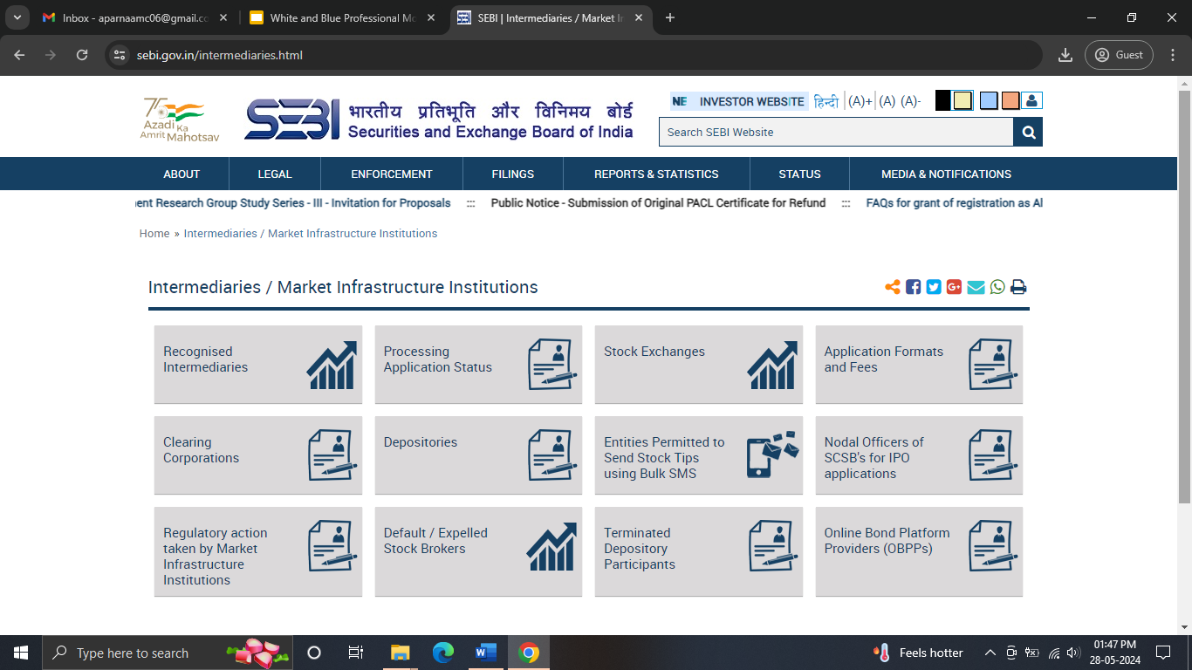
HOW TO CHECK RTA ON SEBI WEBSITE
The list of Recognised Registrar to Issue and Share Transfer Agents can be accessed through the official website of SEBI by following these steps:
STEP 1: Go to the official SEBI website sebi.gov.in and click on the ‘Intermediaries/ Market Infrastructure Institutions’ tab and then click the Recognised Intermediaries tab as shown:
Is the Rule applicable to Nidhi Companies?
Whether Eligible Private Companies are required to maintain a Register?

Slide 31
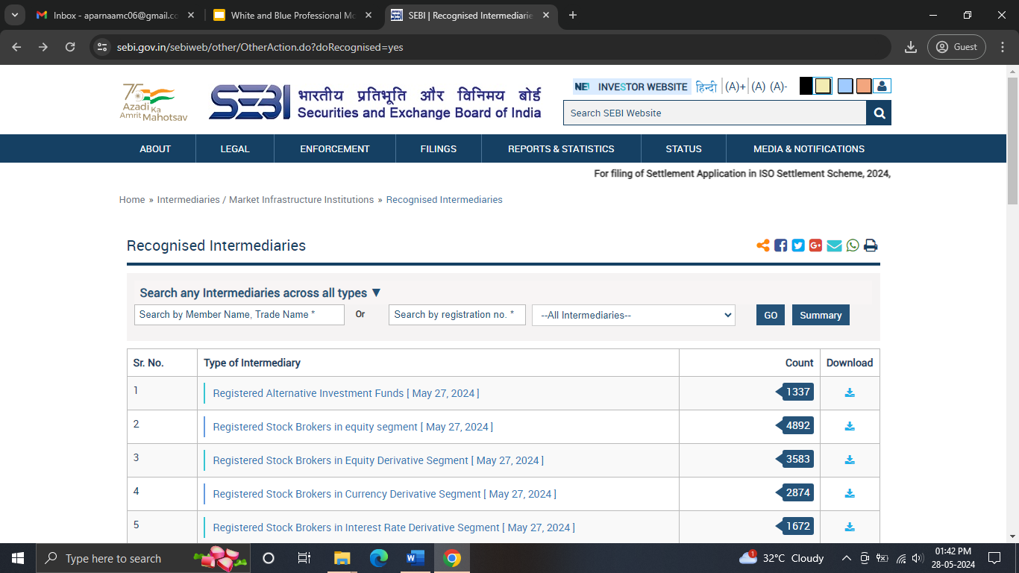
HOW TO CHECK RTA ON SEBI WEBSITE
STEP 2:On clicking the tab named Recognised Intermediaries. You will be redirected to another page with a list of all the recognised intermediaries.
Is the Rule applicable to Nidhi Companies?
Whether Eligible Private Companies are required to maintain a Register?

Slide 32
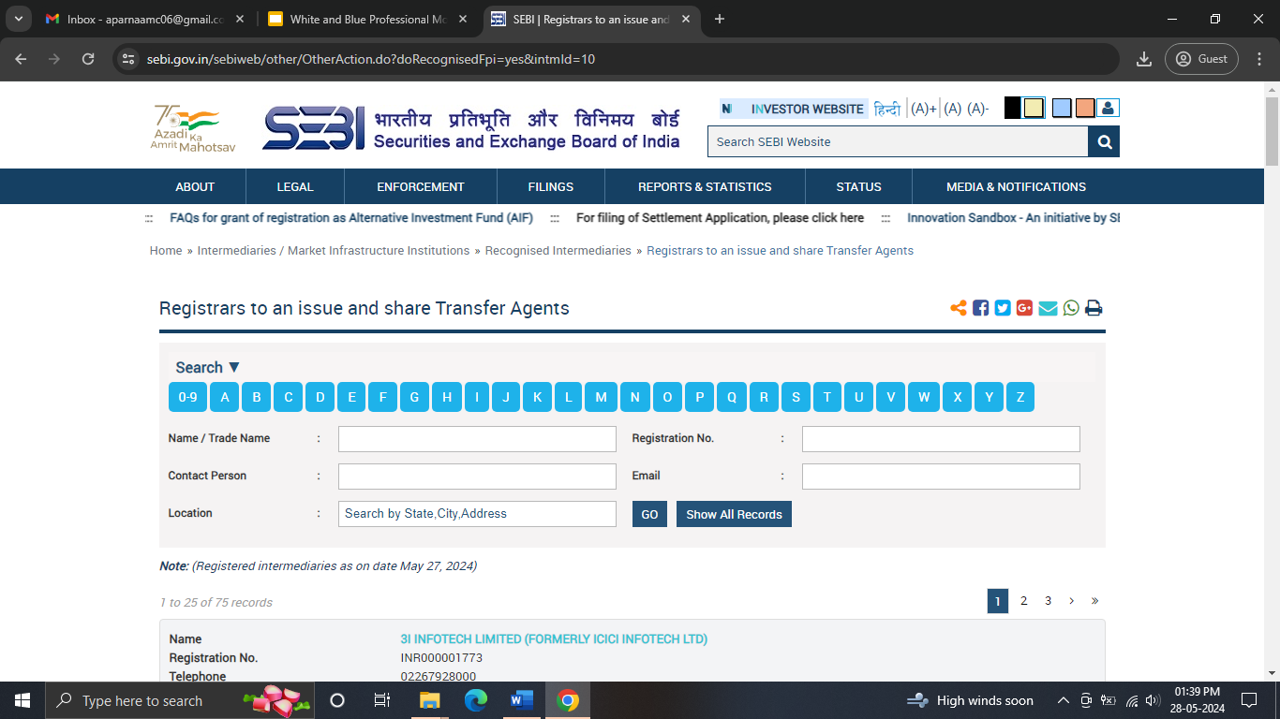
HOW TO CHECK RTA ON SEBI WEBSITE
STEP 3: Scroll and click on the option: Registrars to Issue and Share Transfer Agents. The list shows all the registered RTA as on date.
There are 75 registered RTA as on May 27, 2024.
Is the Rule applicable to Nidhi Companies?
Whether Eligible Private Companies are required to maintain a Register?

Slide 33
Common FAQs on Dematerialisation
Is the Rule applicable to Nidhi Companies?
Whether Eligible Private Companies are required to maintain a Register?
Are the Eligibe Private Companies required to file E-Form PAS-6 for the half-year ended September, 2024?
The Present Amendment is applicable to Private Companies which are NOT Small Companies.
Since Nidhi Companies are public companies, hence this amendment is not applicable to them.
Nidhi Companies are exempted from Rule 9A as well.
No.
In terms of the Depositories Act, 1996, the Register and Index of Beneficial Owners maintained by the Depository shall suffice.
The provisions of the Present Amendment are applicable after 18 months from the closure of FY 22-23 i.e., from October 01, 2024 and therefore the companies will be required to file form PAS-6 for the half year beginning from October 2024 and therefore the first PAS-6 shall be filed for half year ended March 2025.

Slide 34
Common FAQs on Dematerialisation
Whether Eligible Private Companies are required to amend their Articles of Association to include the Demat clause?
Whether the Company can issue/transfer shares without dematerializing before September 30, 2024?
What compliances are required to be undertaken by a Foreign Investor?
Yes.
Private Companies are required to amend their Articles to include the dematerialization clause.
The amendment should be completed before proceeding for seeking ISIN from the Depository.
The foreign investors are required to open Demat accounts with Indian Depositories.
In this regard, the following documentation is required to be carried out:
A. Securing a Permanent Account Number (PAN)
B. Complying with Know-Your-Customer (KYC) norms.
C. Authenticating Documents.
Private Companies are required to ensure compliance by September 30, 2024.
Prior to that, Companies may issue/transfer shares without dematerialization.

Slide 35
OUR RECOMMENDATIONS
1) Removal of Section 8 Companies from ensuring compliance with the Amendment.
2) Introducing E-Form PAS-6 as an Annual form, instead of a half-yearly form.
3) Introducing the concept of “Small” Section 8 Companies.
4) In cases of grievance redressal, the investor has to approach the IEPF Authority. Since the IEPFA can only take action against the RTA and Depository, even Companies should be included within this purview.

Slide 36
INTRODUCING: DEMATERIALIZATION FOR SHARE WARRANTS.
Every Public Company which has issued Share Warrants, prior to introduction of Companies Act, 2013, and not converted the same into shares shall,
Within 3 months, i.e, within January 26, 2024, inform about the details of such share warrants to the Registrar in Form PAS-7.
Within 6 months, i.e, within April 26, 2024, require the bearers of the share warrants to surrender the same to get it dematerialized and the Company shall place a notice for the bearers in Form PAS-8 on its website and newspaper both.
If the holder does not dematerialize such warrants, it shall be transferred to IEPF Authority.

Slide 37
CONCLUSION
The Amendment was brought about with a view to increase transparency and reduce the number of “benami” owners in the existing Private Companies.
While the initiative was taken with an intent to promote good corporate governance, there are a few stumbling blocks- which if overcome by Private Companies, can pave the way for reduced fraud, an efficient system of share transfer and an increased financial inclusivity.
Further, it shall help the regulators keep track of the adequate payment of stamp duty in cases of issuance/share transfer by Private Limited Companies.
As the saying goes, “If you think Compliance is expensive, try non-compliance” and this should indeed be the motto for Private Companies by way of the introduced amendment now.

Slide 38
THANK YOU!
In case of any queries, you may reach out at nupuramc@gmail.com
OR
Contact at +91 94330-53891.
Follow us on:

